Slide 1
Updated PGLS analysis
12/09/2021

Slide 2
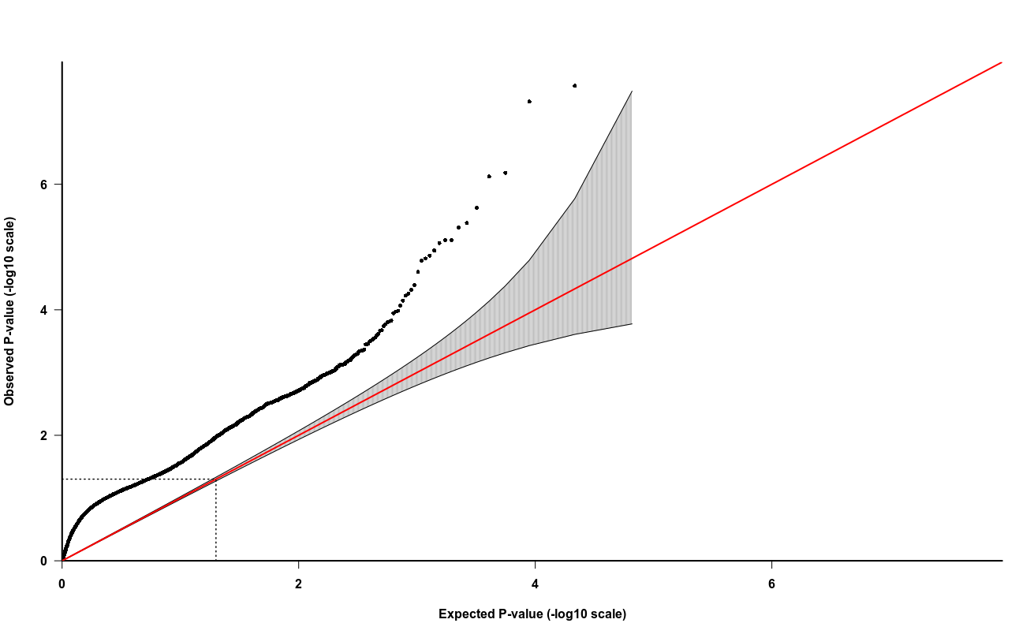
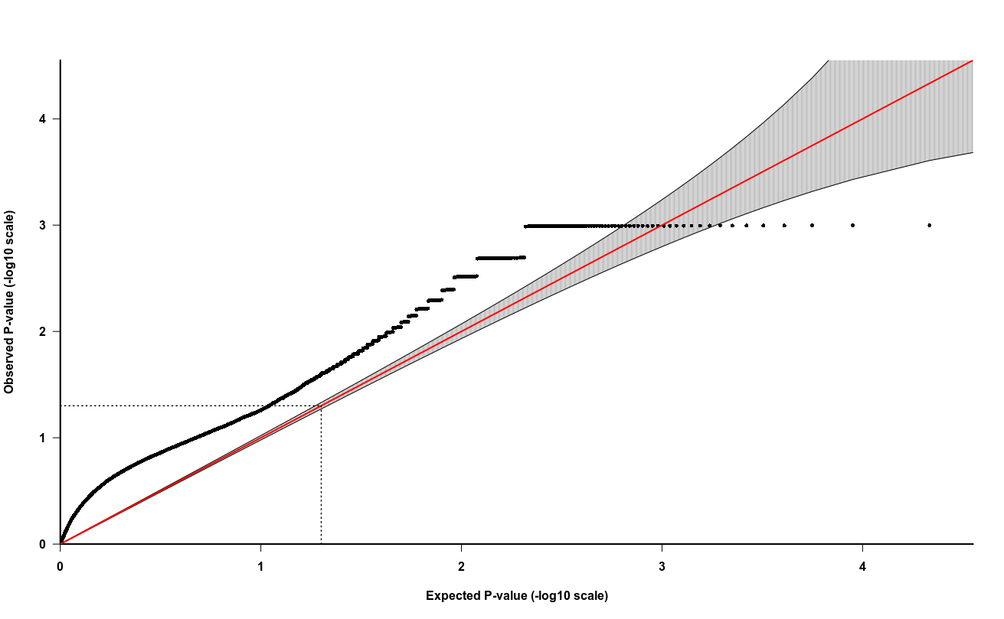
NEOPLASY PREVALENCE
Parametric
Permulated

Slide 3
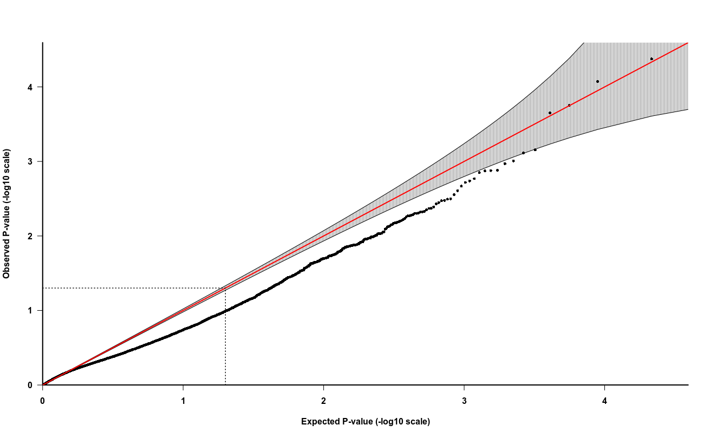
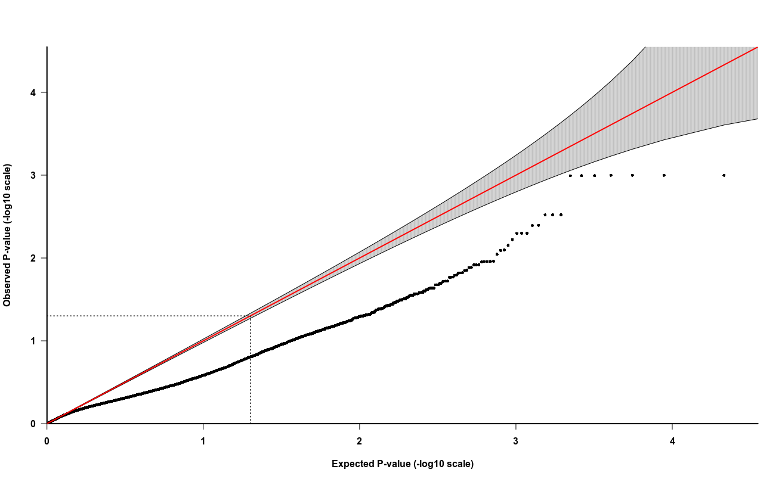
MALIGNANCY PREVALENCE
Parametric
Permulated

Slide 4
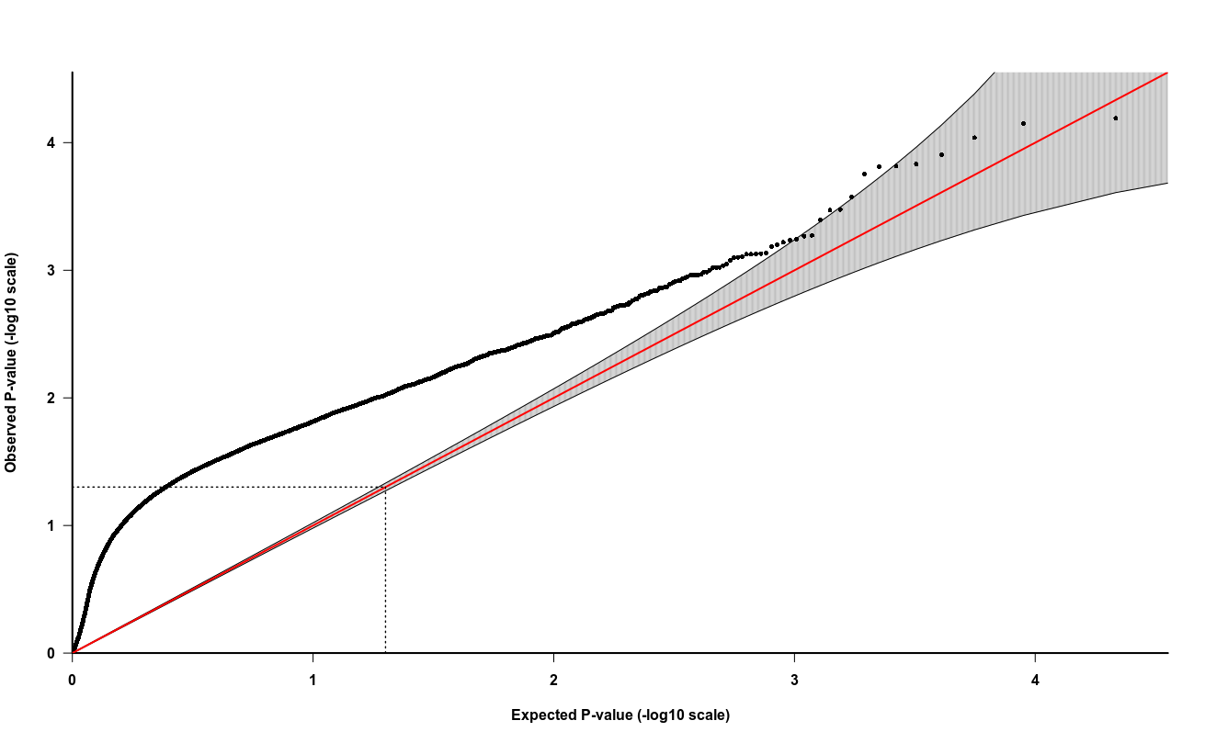
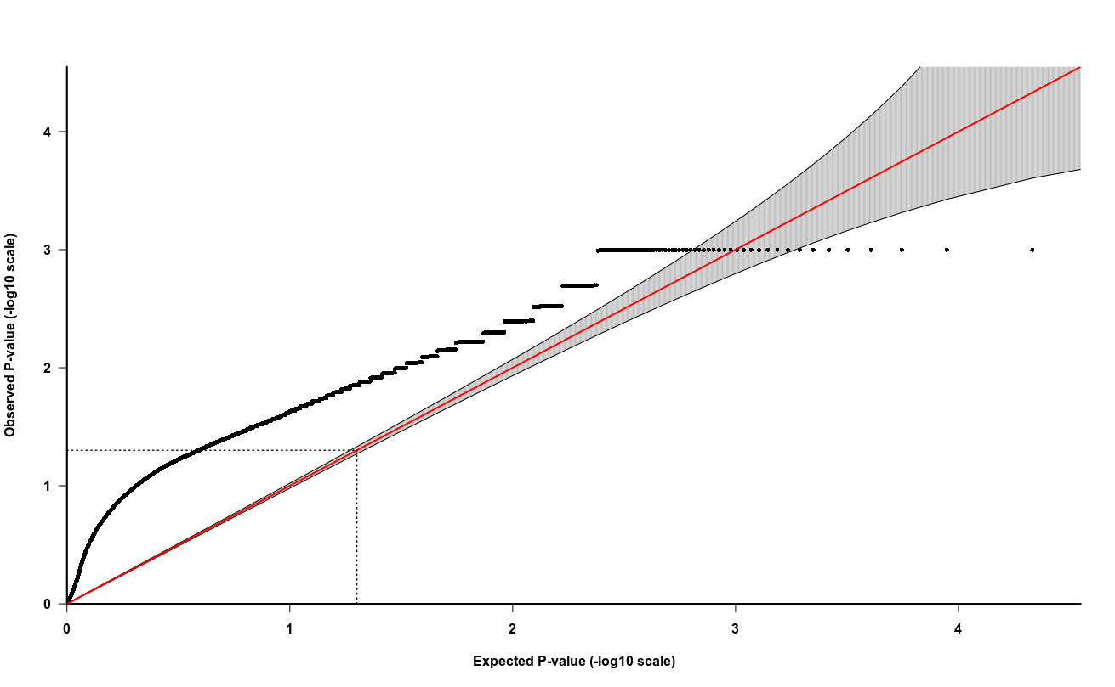
BENIGNANCY PREVALENCE
Parametric
Permulated

Slide 5

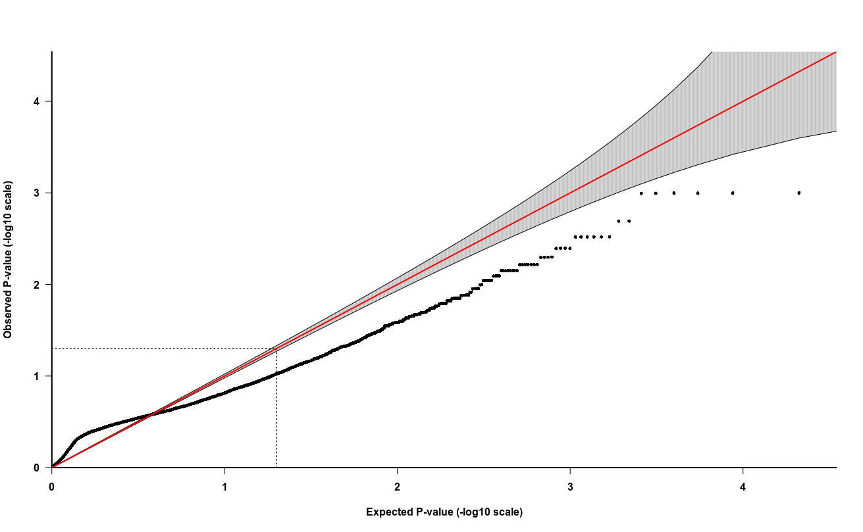
MALIGNANCY PROP
Parametric
Permulated

